Slide 1
What Your Members Want to Know About Consumption

Slide 2
Member Alert and Notification System
Michael Hyde
Northern Neck Electric Cooperative

Slide 3
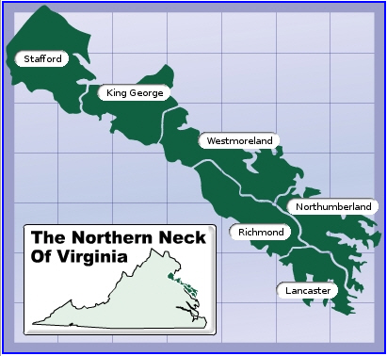
Northern Neck Electric Cooperative
Warsaw, VA
18,500 meters
6 Counties
1,900 miles of line
20 Substations
30% Seasonal

Slide 4
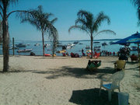

Slide 5
NNEC IT Mission Statement
To the Coop - Provide Cooperative employees the tools and technology to help them perform their job more efficiently and safely To the Members - Provide members with tools to help them reduce energy consumption, save money and preserve the environment

Slide 6
Member Notification Options
eMail
Web site – eBusiness Portal
IHD (In-Home-Displays)
Text Messaging
Phone call (IVR)
Social Media (Twitter, Facebook…)
Mobile Devices (Smartphones)
Apps (iPhone, iPad, Droid)

Slide 7
eMail Notifications
Daily Usage
Monthly Usage (Sent out weekly)
Hourly Usage
High Usage (Alert)
Outage Alert

Slide 8
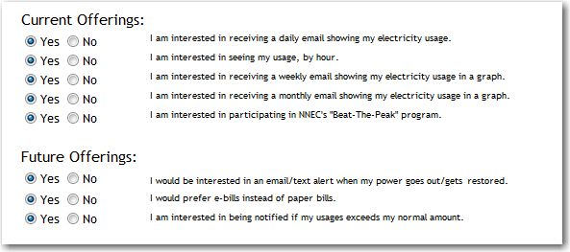
Online Member Profile
Maintained thru ebusiness portal
Username and Password protected
Updates the CIS files
Currently using BLPNAMST.NALANG

Slide 9
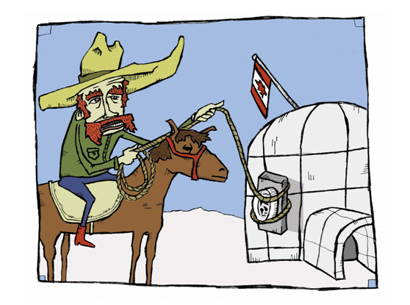
Reading Process

Slide 10

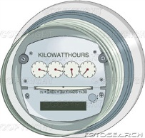

Reading/Reporting Process
12:01 – Meter reads start
6:30 – Automated Retry Batch
7:00 – Automated Retry Batch
8:00 – Pings/reads/investigations (Manual)
12:00 – Meter Read jobs stop
12:10 - Files FTP’d to CIS
12:15 – CIS Import Job starts
12:30 - Audit Reports
Inactive Locations with Usage
Blink Report
Abnormal Usage Report
1:00 – Daily Usage Report
1:45 – High Usage Alert
2:00 - Weekly Report (Fridays)
2:30 – Hourly Usage Report

Slide 11
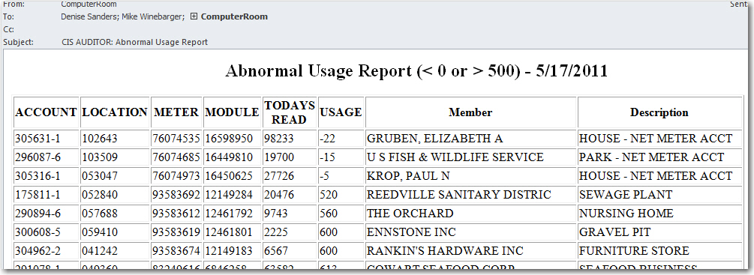
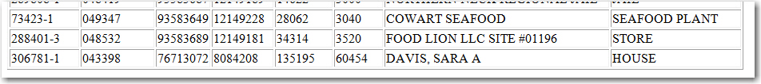
Obtain Accurate Readings
Abnormal Usage Report (Less 0, > 500)
eMailed Daily to IT
Normally 20-25 Accounts
Helps find erroneous reads

Slide 12
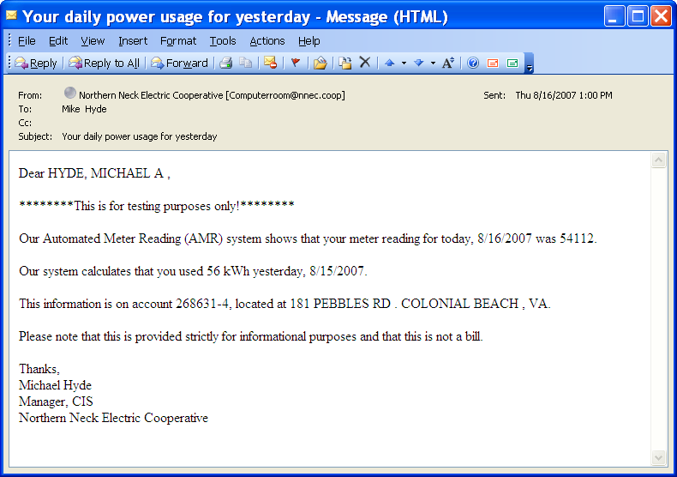
Daily Usage eMail Notifications Pilot
August 2007
Very Basic information
Provided reading
Calculated usage
Sent to:
Employees
Board Members

Slide 13
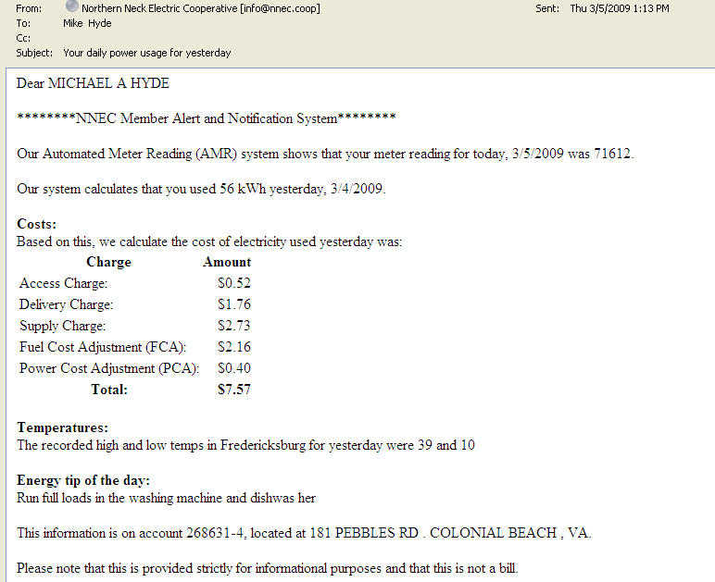
Daily Usage eMail Notifications Modifications
March 2009
Added information
Provided reading
Calculated usage
Dollar value
Hi/low temp
Energy Tip
Data pulled from CIS

Slide 14
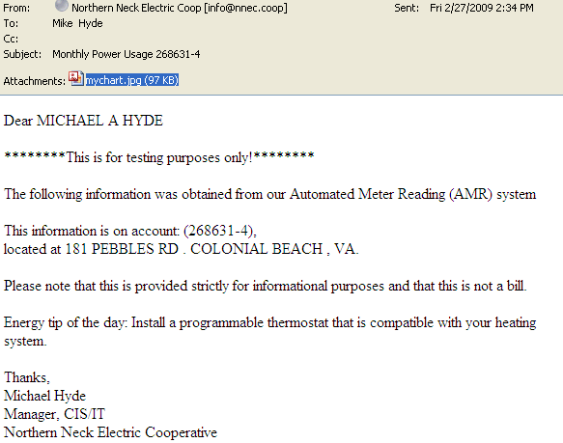
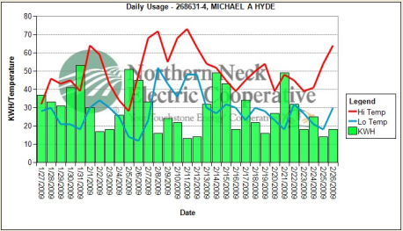
Weekly Usage eMail Notifications
30 days prior usage
Hi/Low temp
Data pulled from CIS
Energy Tip
2008

Slide 15
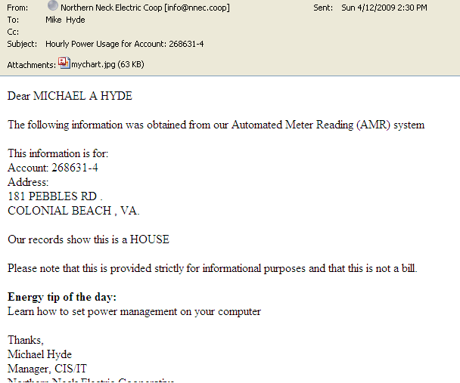
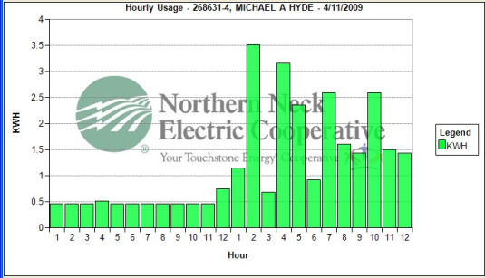
Hourly Usage eMail Notifications
Hour-by-hour usage
Pulled from TWACS
Energy Tip
2008

Slide 16
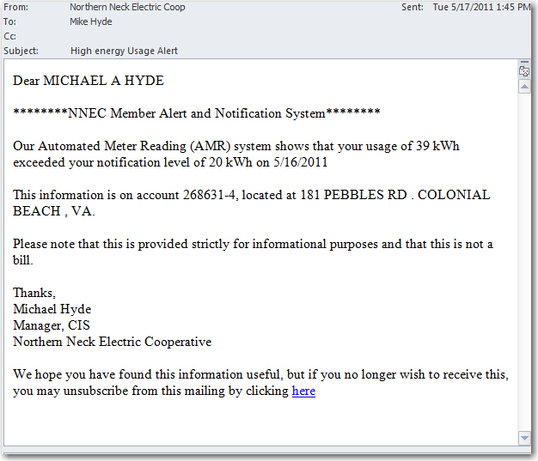
High Usage eMail Notifications
eMail sent to member if their daily usage exceeds their set threshold.
Future plans may add text or phone alerts.

Slide 17
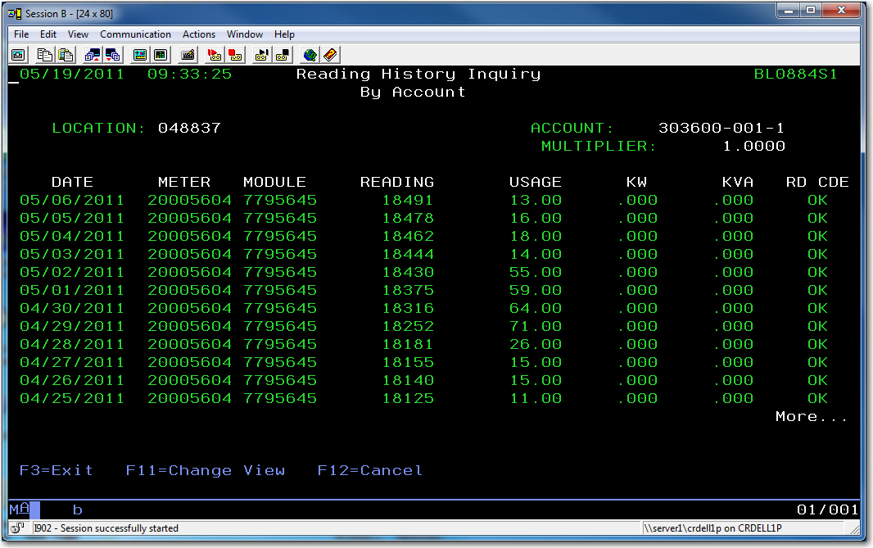
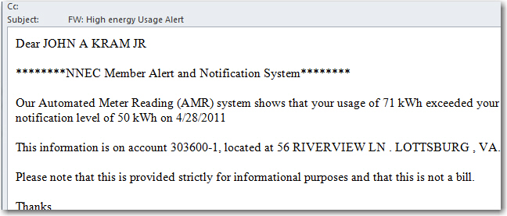
High Usage eMail Notifications Case Study Example

Slide 18
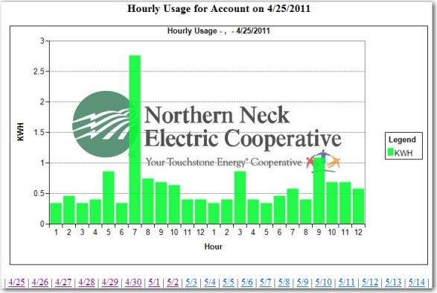
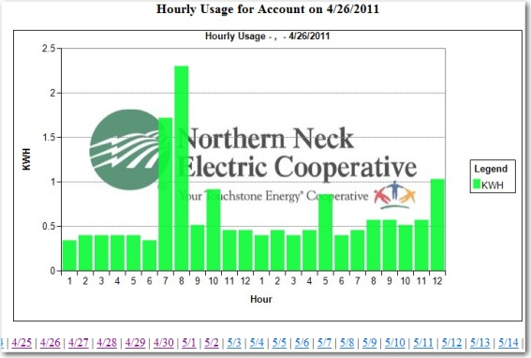
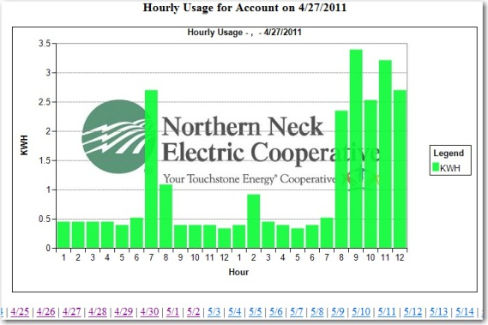
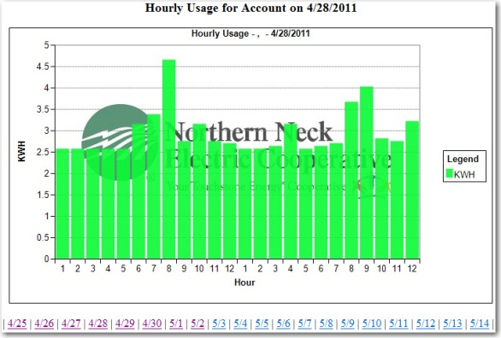
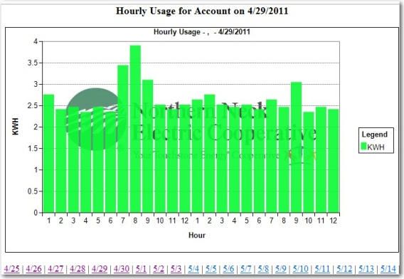
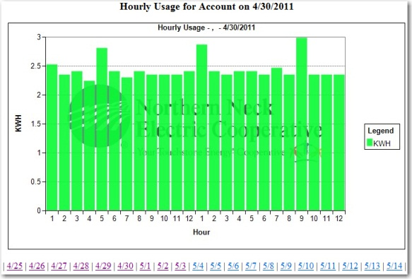
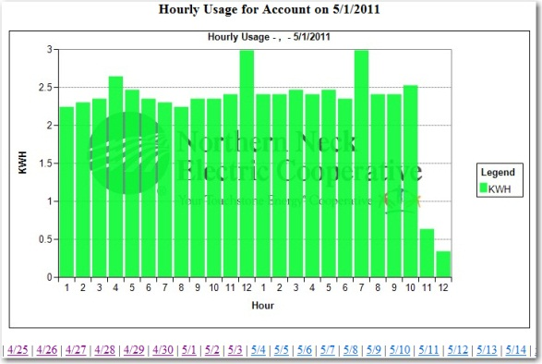
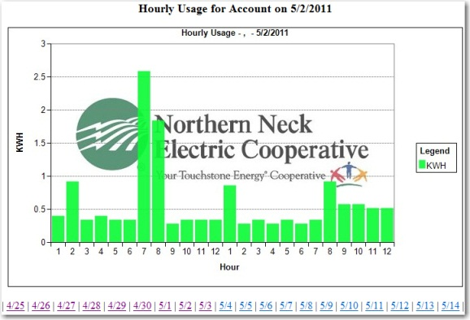
High Usage eMail Notifications Example
4/28 – Noticed slight rise in usage via email (15 >26)
4/29 – Large usage (71)
Raised thermostat to 80
Left for weekend
5/1 – Returned home, Turned breaker off
Bad contacts on AC Compressor

Slide 19
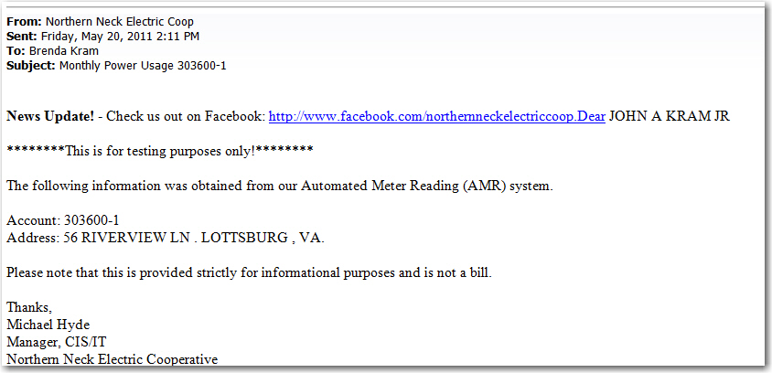
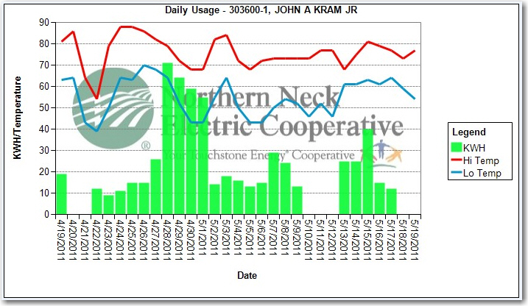
High Usage eMail Notifications Case Study Example
Weekly email, showing previous 30 days usage.

Slide 20
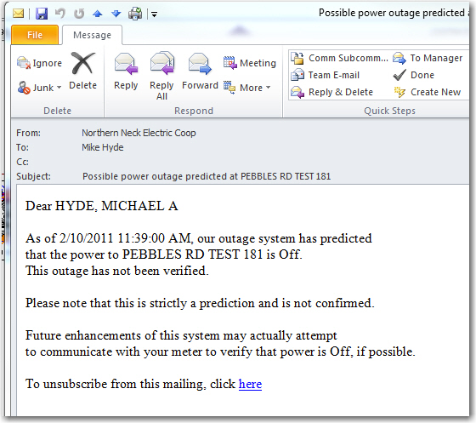
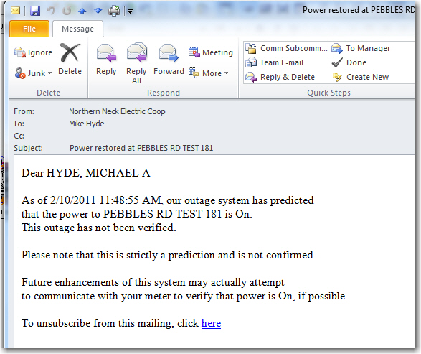
Member Outage Notification Phase 1
Currently notifying member of outages/restorations based on outage data

Slide 21
Member Outage Notification Phase 2
Create scheduled job to ping subscribed members
How often?
Where to store the results?
Scheduled job or Run-as-service?
Have to check sub-status
Suspend during “Major Storm?”
Parameters to create an outage ticket?

Slide 22
Energy Portals & Tools
TED – The energy Detective
Google Powermeter
Microsoft Hohm
MyMeter
OPower
Apogee

Slide 23
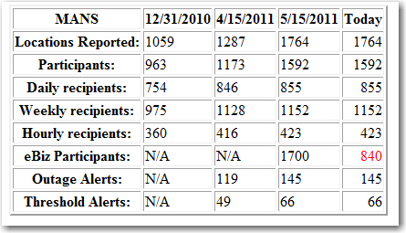
MANS Participation
“If you cannot measure it,
you cannot improve it.”
-- Lord Kelvin

Slide 24

What's in the Future?
Zero usage notification
Add Text Capability
App (iPhone, iPad, Droid)
Comparative Usage
Demand Response
Beat-the-Peak
Smart Home
Trend Analysis
MultiSpeak
Ability to set markers Usage comments by members)
Expand Comparison (2 years)

Slide 25
Thank You!
Michael Hyde
mhyde@nnec.coop

